Slide 1
REC

Slide 3
Group 8

Slide 4





Thành viên trong nhóm
Lê Trung Hiếu
Nguyễn Bá Trung
Nguyễn Duy Cương
Nguyễn Đức Mạnh
Nguyễn Đức Thắng

Slide 5


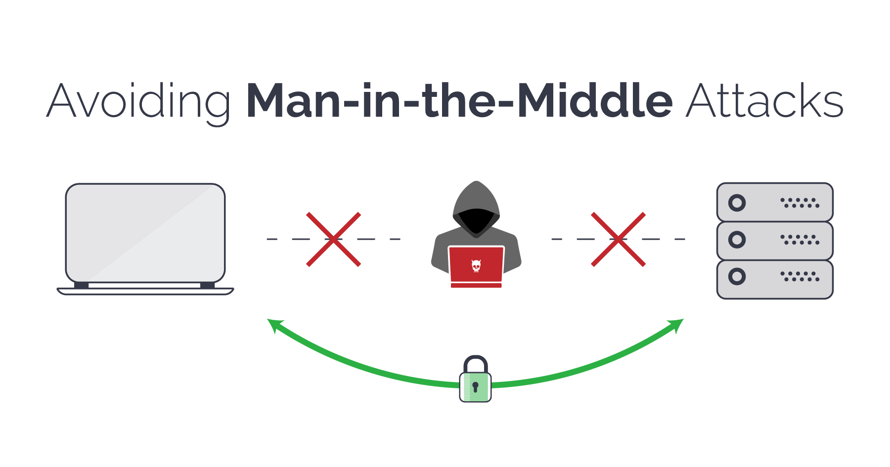

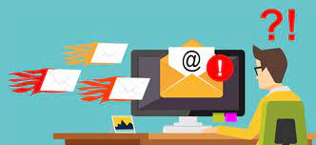
Attack (2)
Việt Nam
Group
8
NỘI DUNG
KẾT LUẬN
TỔNG KẾT

Slide 6
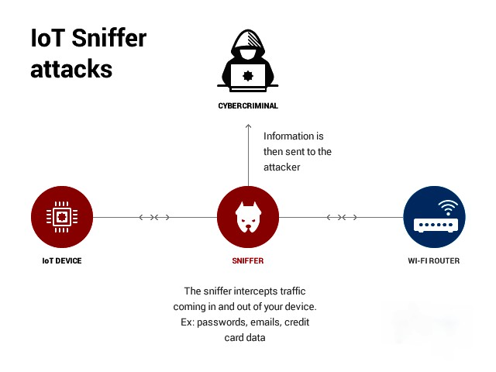
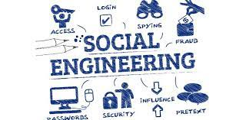


Attack (2)
Việt Nam
Group
8
NỘI DUNG
KẾT LUẬN
TỔNG KẾT

Slide 7
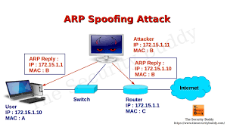
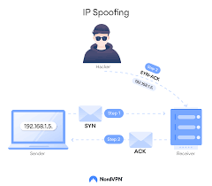
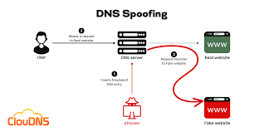

1
Spoofing
Spoofing is a technique of falsifying or manipulating information to deceive users or computer systems.
ARP Spoofing
Some types of spoofing attacks :
IP Spoofing
DNS Spoofing
1
2
3
4

Slide 8
1
Spoofing
To defend against Spoofing attacks, there are several measures that users and organizations can implement:
- Use security software
- Use a Virtual Private Network (VPN)
- Regularly update software
- Use encryption
- Verify the source
- Limit personal information disclosure
1
2
3
4

Slide 9
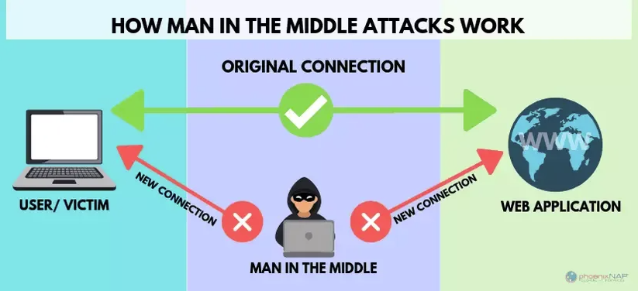
2
Man in the middle
Man-in-the-middle (MITM) attack is a type of attack where the attacker intercepts a connection between two parties in order to eavesdrop, alter, or steal information.
Packet sniffing
IP Spoofing
Some types of spoofing attacks :
DNS Spoofing
ARP spoofing
SSL stripping
1
2
3
4

Slide 10
1
Spoofing
2
Man in the middle
To prevent Man-in-the-Middle (MITM) attacks, there are several useful security measures:
Use a strong security protocol such as HTTPS or SSL
Install and use good security software
Use a VPN (Virtual Private Network) application
Only use trusted network connections and avoid connecting
Use antivirus software and a firewall
1
2
3
4

Slide 11
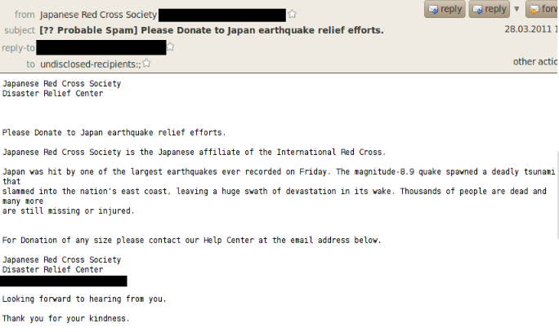
3
Spam
Spam is unsolicited commercial e-mail.
Scam: Attackers send fake emails to scam users
Here are some types of spam attacks:
malware: The attack sends emails containing malicious software such as viruses, worms or trojans.
1
2
3
4

Slide 12
3
Spam
Spam has been used as means of enhancing malicious code attack. In March 2002, there were reports of malicious code embedded in MP3 files that were included as attachments to spam
Consequence:
Spam is the waste of computer and human resources.
cope with the flood of spam by using e-mail filtering technologies
measure:
delete unwanted messages
1
2
3
4

Slide 13
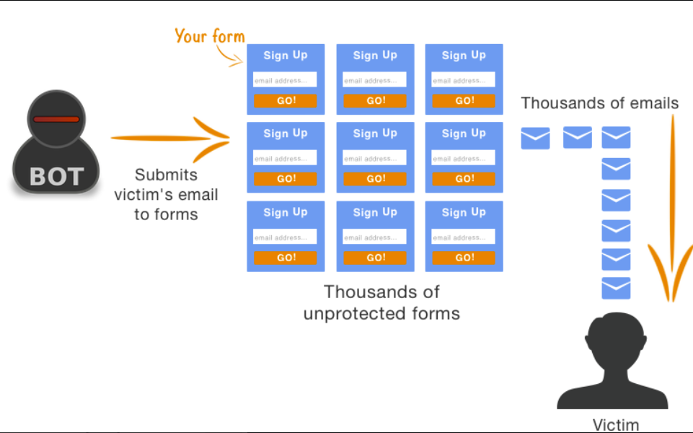
4
Mail Bombing
Another form of e-mail attack that is also a DoS is called a mail bomb, in which an attacker routes large quantities of e-mail to the target.
-Mail bombing can be accomplished by means of social engineering (to be discussed shortly) or by exploiting various technical flaws in the SMTP.
-The target of the attack receives an unmanageably large volume of unsolicited e-mail
1
2
3
4

Slide 14
4
Mail BomBing
When mail bombing is carried out by a large number of computers, it can cause a distributed attack (DDoS) and render the attacked email address inaccessible.
Consequence:
Use spam filtering tools
Measure:
Do not share your e-mail address too widely
1
2
3
4

Slide 15
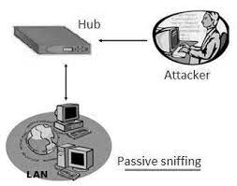
5
Sniffers
A sniffer is a program or device that can monitor data traveling over a network
Alright, here are some types of sniffing attacks :
+ Passive sniffing :
1
2
3
4

Slide 16
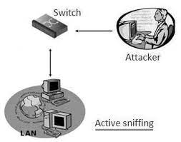
5
Sniffers
+ Active sniffing :
Consequence:
Use data encryption
Use strong authentication
Use network monitoring tools
1
2
3
4

Slide 17
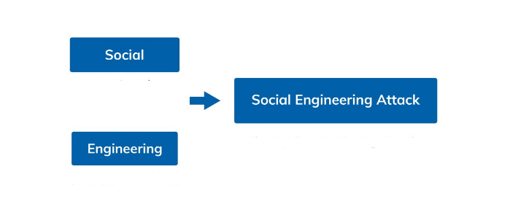
6
Social Enginering
"Social Engineering" is a type of attack that combines the two words "Social" and "Engineering," reflecting the nature of this type of attack: the tricks, techniques, and tactics used to attack the social nature of human beings, which does not exist in machines.
Social Engineering Attacks are also known as Non-Technical Attacks.
1
2
3
4

Slide 18
6
Social Enginering
Personal information loss
Account theft
Social engineering :
Network attacks
Money loss
Reputation damage
1
2
3
4

Slide 19
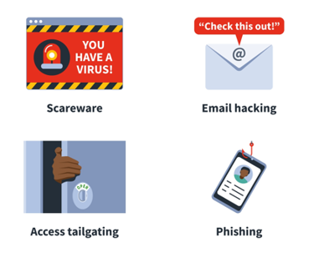
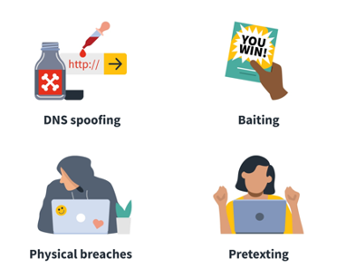
6
Social Enginering
Examples of Social Enginering :
1
2
3
4

Slide 20
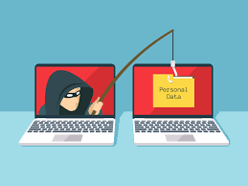
6
Social Enginering
Phishing is a type of cyber attack where attackers send fake emails, text messages, or websites that appear to be from a legitimate source, such as a bank, social media platform, or online retailer. The aim of phishing is to trick the recipient into revealing their personal or sensitive information, such as login credentials, credit card numbers, or social security numbers, by pretending to be a trustworthy entity. Phishing attacks often use urgent or persuasive language to make the recipient act quickly without thinking, and can lead to identity theft, financial losses, and other security risks.
1
2
3
4

Slide 21
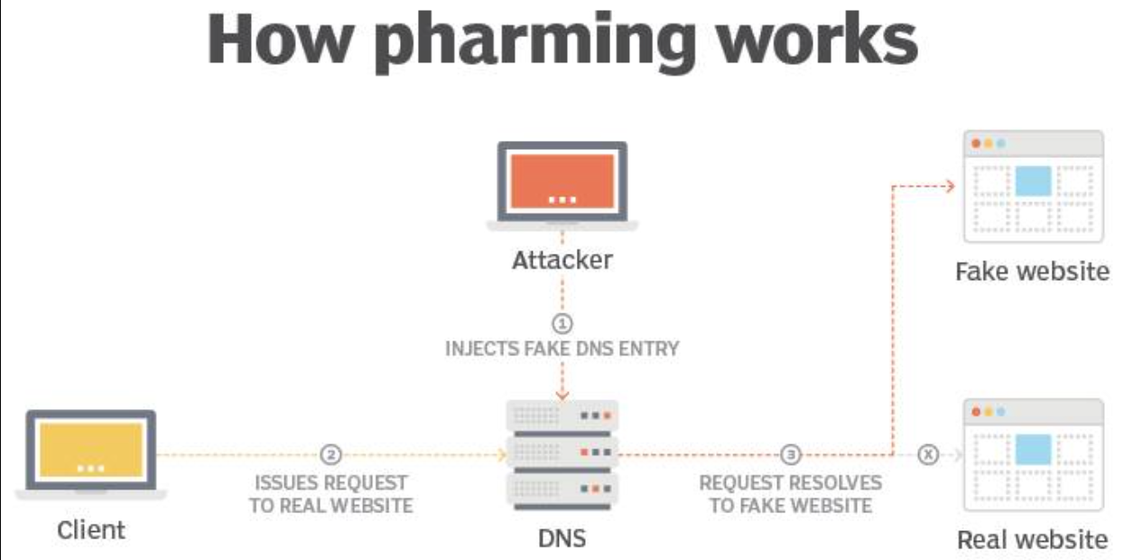
7
Pharming
Pharming is a network attack technique where attackers use methods to infiltrate computer systems to control DNS (Domain Name System) routers to redirect users to a fake website
Change your computer's DNS router configuration
Exploit sensitive information
Exploit user accounts and passwords
Consequence:
1
2
3
4

Slide 22
7
Pharming
using secure, encrypted connections
Measure:
regularly updating security software
using anti-virus software and security patches, and using software anti-malware and anti-phishing
1
2
3
4

Slide 23
8
Timing
A Timing Attack is a cyber attack technique used to analyze and measure the response time of a system or web application. This technique is used to find sensitive information such as passwords, keys or other information using differential analysis in system response time.
find out sensitive information such as passwords
passcodes or other information
Consequence:
1
2
3
4

Slide 24
8
Timing
Using random response times or limiting the number of consecutive false login requests
Measure:
Using stronger encryption algorithms
Using two-factor authentication systems
1
2
3
4

Slide 25
Thanks for watching

